Slide 1
Halal brand communication
Dr. Rosmiza Bidin
Universiti Putra Malaysia

Slide 2
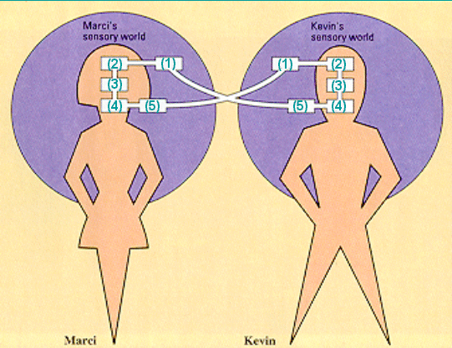
Communication Process Model
Notes:
This model guides your discussion of the communication process, the first cycle.

Slide 3
Definition
Corporate communication is:
  a management function
  that offers a framework for the effective coordination of all internal and external communication
  with an overall purpose of establishing and maintaining favourable reputations
  with stakeholder groups upon which the organization is dependent.

Slide 4
Drivers of Strategic Communication
Regulatory imperatives
  New regulation, revisit comm strategies and practices
Organisational complexities
  Org grows in size and complexity – more markets, customers, products, services, employees, suppliers, etc, - hihger need for a consistent comm strategy

Slide 5
Drivers of Strategic Communication
The need to increase credibility
  Approval and trust from public
Aligning communication with strategy
  Multiple constituents, responsive comm to all.
  Consistency of the messages

Slide 6
Points to ponder…
Why choose Petronas over Shell?
Why study/work in Universitas Malang?
Do you know that Nestle paid six times the net asset value to buy Rowntree and its spectacular portfolio of brand including Kit Kat and Smarties.

Slide 7
General scenario…
Competition increases
Competitors can copy
processes, products, systems,
services, technology, quality, etc
There is only identity/ brand that remains as a differentiator

Slide 8
Importance
Importance of corporate identity
  Customers
    Inspires confidence (van Riel, 1995)
    Increases visibility and reach (Keller and Aaker, 1998)
    Improves credibility (Fombrun and van Riel, 2004)
    Aids learning (Allesandri, 2001)

Slide 9
Importance
Importance of corporate identity
  Employees
    Helps internalize the company’s values (Dutton and Dukerich, 1994
    Recruits and retains employee (Fanning, 1990)
    Instills identity/brand values into key processes (Organ, 1990)
    Increases identification (O’Reilly and Chatman, 1986)
  Media, Investors, Financial analysts
    Reputation (Whetten and Makey, 2002)
    Attracts favourable responses (Fombrun and van Riel, 2004)

Slide 10
CORPORATE IDENTITY
Identity components (Melewar and Karaosanoglu, 2006)
Corporate structure – brand structure, organizational structure
Corporate strategy – positioning and differentiation strategy
Corporate culture – mission, vision, values
Corporate behaviour – company, management and employee behaviour
Corporate design – slogan, architecture, office layout, location, website
Corporate communication – marketing, management and organizational comm..
Industry identity

Slide 11
Identity, Image & Reputation?
Corporate Identity
Names, Brands, Symbols, Self-presentations
is perceived by…
Customer Image
Community Image
Investor Image
Employee Image
Sum of perceptions equals…
Corporate Reputation

Slide 12
What is Branding?
Branding is endowing products and services with the power of the brand.

Slide 13
What is Brand Equity?
Brand equity is the added value endowed on products and services, which may be reflected in the way consumers, think, feel, and act with respect to the brand.

Slide 14
Brand Halal
Halal has now become an International Brand.
A brand label globally recognized among Muslims & non Muslims for
‘Good Quality & Healthy products’

Slide 15
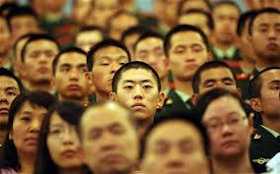
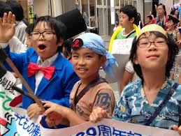
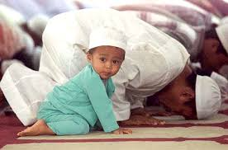
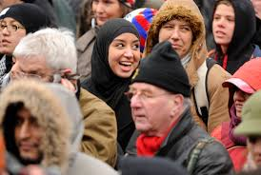
Growing interest in Halal by many countries
Given that the concept of Halal was designed to be universal
“Oh Mankind, eat what is Halal (lawful) and Thayyib (good, healthy)”

Slide 16
Global Players
The Halal products are recognized as
Good Quality & Healthy products
so a big number of
non-Muslims consumers
also buy Halal products.

Slide 17
Global Players
Players from every sector incl. the big multinationals
are trying to capture a share of the growing Halal
market.
Famous international brands and major
hypermarkets in the world are some examples.
Latest addition is world’s biggest store Walmart,
who started sourcing Halal products for Muslim customers

Slide 18
Global Halal Market
World Halal Forum & TIME Magazine
Total size of Global Halal food market is $632 billion.
Based on Muslim population of approx 1.73 billion.
Total figure will be much higher with non-Muslim consumers
The total Global Halal market ranges around US$ 3 trillion per annum.
Notes:
As per the latest research by World Halal Forum and quoted in TIME Magazine, the total size of Global Halal food market is worth about $632 billion.
This is based on the world Muslim population of approx 1.73 billion. However, if we also include the non-Muslim consumers, the total figure will be much higher.
Experts believe the size of the total Global Halal market including Halal food, Consumer products, cosmetics, pharmaceutical, logistics and other Halal related services, ranges between US$ 2 to US$ 3 trillion per annum.

Slide 19

GLOBAL HALAL MARKET
The USD $ 3 Trillion Global Halal Market is divided in the following sectors:
SECTOR | Halal Market 2013 US $ (Billions)
Halal Food | $ 1,292
Islamic Finance | $ 1,214
Islamic Fashion | $ 266
Halal Tourism | $ 140
Media & Recreation | $ 185
Halal Pharmaceuticals | $ 72
Halal Cosmetics | $ 46
Potential Halal Market 2019, US $ (Billions)
$ 2,536
$ 4,178
$ 484
$ 238
$ 301
$ 103
$ 73
Source: State of the Global Islamic Economy 2014-2015/ by Thomas Reuters & DINAR Standard

Slide 20
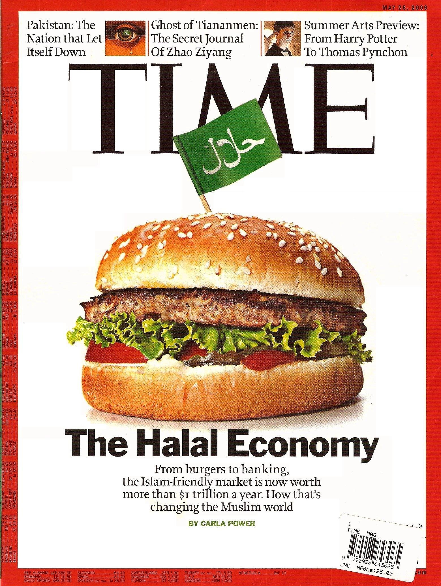
Time Magazine (May 2009)
Notes:
Favorite issue of Times magazine, the most authentic journal in the world which printed a cover story claiming its research showed Halal food trade is more then 1 trillion dolrs a year. This was in 2009 and now in 2014, it is more then 3 trillion dollars

Slide 21
Halal Umbrella
Food products (Edibles)
Food Ingredients & Raw materials
All type of Packaged Food & Beverages
Agriculture products and Seafood
Special Food, Herbal food, Baby Food, Health Food
Flavors and Fragrances,
Food Service (restaurants, café, fast food, catering)
Meat & Poultry Abattoirs / slaughter houses
Pharmaceuticals & Nutraceuticals
Herbal, Ayurveda, Homeopathic, Unani

Slide 22
Halal Umbrella
Non-Food products
Cosmetics, Personal Care
Body care, Toiletries, Perfumes.
Animal & Poultry Feed
Leather products, Apparel & accessories
Packaging & Processing material & equipment

Slide 23
Halal Umbrella
Services
Hospitality & Tourism services incl Hotels
Medical tourism & Health care incl Hospitals & Clinics
Banking & Finance | Takawful | Logistics etc.
Logistics services (Transport, Storage)
Consultancy Services & other Services
Halal Trading Services (incl importer, exporter, whole seller, distributer, retailer, Shop, super market)

Slide 24
Global Halal Target Market
Asia : More than 1.1 Billion Consumers
(including UAE and GCC)
Africas: Over 470 million Consumers
(East, West, North, South, Central)
EUROPE: More then 50 million Consumers
Americas: Halal Consumers almost 10 million
(USA, Brazil, Canada, Central, South & Caribbean)
Oceania: 0.6 million Consumers in New Zealand, Australia
and Fiji

Slide 25
Biggest Halal Food
Consumers
Some examples of the Halal Food market size:
Europe, over $66 billion. (with only France $17 billion)
America, spends over $13 billion on Halal food annually.
GCC’s food imports is $26 billion.
Egypt consumes approx $88 billion
Pakistan consumption is almost $93 billion
Turkey consumes aprox $100 billion
Indonesia’s annual Halal Food consumption is $197 billion.
Other major consumers of Halal Food include Malaysia, Iran, Africa, and other Muslim countries.

Slide 26
Our research…
In the development and promotion of Malaysia as the global halal hub, one of the eleventh strategic thrusts is enhancing the awareness on the identity of Malaysia as the center for halal products and services.
However, research indicates some ambiguities surrounding corporate identity in Halal industries.

Slide 27
Our research…
The objective of this study is to examine, the relationships between corporate identity management (CIM) in Halal industry and employee performance and also the relevant underlying mechanisms in a Malaysian Halal industry context.

Slide 28
Our research…
This study will employ a quantitative methods approach
Involving semi structured interviews (10-15 respondents) and a pilot survey (100 respondents) for the development of measurement scales.
The main survey (500 respondents) to test the research hypotheses and the proposed conceptual model.

Slide 29
Our research…
This study proposes a conceptual model of the positive relationships between CIM activities in halal industry with corporate culture, employee values, internal brand and employee performance as determinants of CIM activities. Employee performances are proposed as consequences of CIM.

